Slide 1
UNIT-III
Software Requirements Analysis, Design and Construction:
I - SRS ,requirement elicitation techniques;
II - techniques for requirement modelling
III - software metrics

Slide 2
REQUIREMENTS ENGINEERING PROCESSES
The objective of this chapter is to discuss the activities involved in the requirements engineering process.
There are a number of generic activities common to all processes
  Feasibility study
  Requirements elicitation and analysis
  Requirements specification (documenting)
  Requirements validation

Slide 3
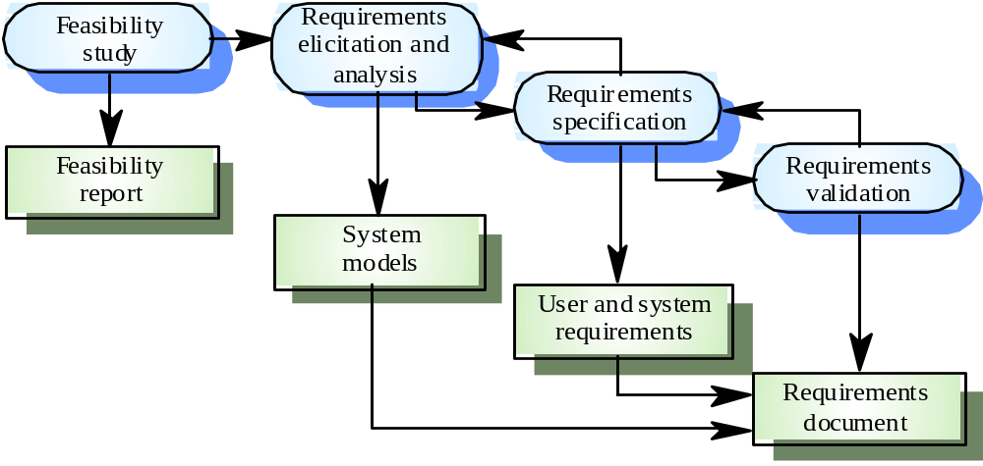
Requirements engineering processes

Slide 4
    However, there are a number of generic activities
    common to all processes
  Feasibility study
  Requirements elicitation and analysis
  Requirements specification (documenting)
  Requirements validation
  Note: Requirements management is an additional activity to manage changing requirements
  FEASIBILITY STUDY
  A feasibility study decides whether or not the proposed system is worthy to implement .

Slide 5
    Feasibility study implementation
    1.INFORMATION ASSESSMENT (what is required),
    2.INFORMATION COLLECTION
3.REPORT WRITING

Slide 6
    Feasibility study implementation
    1.INFORMATION ASSESSMENT (what is required),
A short focused study that checks
  If the system contributes to organisational objectives
  If the system can be engineered using current technology and within budget
  If the system can be integrated with other existing systems
    2.INFORMATION COLLECTION
Questions for people in the organisation
(proj managers,software engineers,technology experts,end users )
  What if the system wasn’t implemented?
  What are current process problems?
  How will the proposed system help?
  What will be the integration problems?
  Is new technology needed? What skills?
  What facilities must be supported by the proposed system?
    3.REPORT WRITING

Slide 7

Req management
Change control
Version control
Req status tracking
Req s tracing

Slide 8
SOFTWARE METRICS AND METRICS BASED CONTROL METHODS

Slide 9
Examples of Metrics from Everyday Life
Working and living
  Cost of utilities for the month
  Cost of groceries for the month
  Amount of monthly rent per month
  Time spent at work each Saturday for the past month
  Time spent mowing the lawn for the past two times
College experience
  Grades received in class last semester
  Number of classes taken each semester
  Amount of time spent in class this week
  Amount of time spent on studying and homework this week
  Number of hours of sleep last night
Travel
  Time to drive from home to the airport
  Amount of miles travelled today
  Cost of meals and lodging for yesterday

Slide 10
Measures, Metrics, and Indicators
These three terms are often used interchangeably, but they can have subtle differences.
Measure
  Provides a quantitative indication of the extent, amount, dimension, capacity, or size of some attribute of a product or process
Measurement
  The act of determining a measure
Metric
  (IEEE) A quantitative measure of the degree to which a system, component, or process possesses a given attribute
Indicator
  A metric or combination of metrics that provides insight into the software process, a software project, or the product itself

Slide 11
Measure
– provides a quantitative indication of the extent, amount, dimension, capacity or size of some attribute of a process or product.
– Example: Number of defects found in component testing. LOC of each component.
Measurement
– The act of collecting a measure.
– Example: Collecting the defect counts. Counting LOC.

Slide 12
Metric (IEEE Standard Glossary of Software Engineering Terms) :
– A quantitative measure of the degree to which a system, component or process possesses a given attribute. It relates measure in some way.
– Example: defects found in component testing/LOC of code tested.
• Indicator :
– A metric that provide insight into the SW process, project or product.
– Indicators are used to manage the process or project.

Slide 13
Measurement Principles
Formulation
Collection
Analysis
Interpretation
Feedback

Slide 14
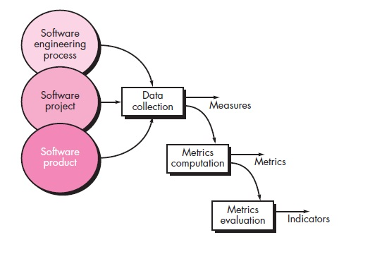
Software metrics collection process

Slide 15
Software Metrics
Software process and product metrics are quantitative measures that enable software people to gain insight into the efficiency of software process and the projects that are conducted using the process as a framework.

Slide 16
Software Metrics refers to a range of measurements for computer software that enable software people to gain insight into the project:
– To improve the Process and the Product
– Assist in Estimation
– Productivity Assessment
– Quality Control
– Project Control

Slide 17
How are metrics used?
Measures are often collected by software engineers and used by software managers.
Measurements are analysed and compared to past measurements, for similar projects, to look for trends (good and bad) and to make better estimates.

Slide 18
Reasons for measuring Software processes, products, and resources: –
To characterize
  To gain understanding of Product, Process, and ?
  To establish baseline for future comparisons
To evaluate
  To determine status within the plan
To predicate
  So that we can plan. Update estimates
To improve
  We would have more information “quantitative” to help determine root causes

Slide 19
Metrics guidelines
Use common sense and organizational sensitivity when interpreting metrics data.
Provide regular feedback to the individuals and teams who collect measures and metrics.
Do not use metrics to appraise individuals.
Set clear goals and metrics that will be used to achieve them.
Never use metrics to threaten individuals and teams.
Metrics that indicate a problem area should not be considered a problem, but an indicator for process improvement.
Do not obsess on a single metric.

Slide 20
Types of Metrics
Process Metrics
Product Metrics
Project Metrics

Slide 21
Process Metrics:
These measures used to quantify characteristics of the software process.
Usually related to events or things that occur.
Examples: # defects found in test, # requirements changes, # days to complete task …
Project Metrics:
used to manage the software project “Tactic”.
Estimating cost is the first application of Project Metrics
Examples: estimates of software development time based on past projects.

Slide 22
Product Metrics:
These measurements relate to software product and all related artifacts.
Examples: code, design docs, test plan, user manual…LOC, # of pages, # of files.
Measures can also be used to evaluate the software quality.

Slide 23
Process and Project Metrics

Slide 24
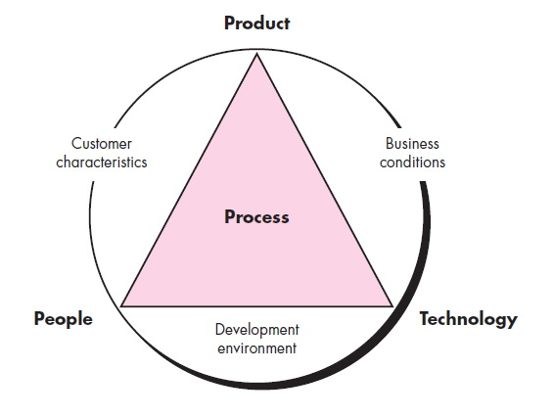
Process Metrics and Software Process Improvement

Slide 25
Software Measurement
Two categories of measurement:
  Direct measures
    Direct measures of the product include lines of code (LOC) produced, execution speed, memory size, and defects reported over some set period of time.
  Indirect measures
    Indirect measures of the product include functionality, quality, complexity, efficiency, reliability, maintainability, and many other.

Slide 26
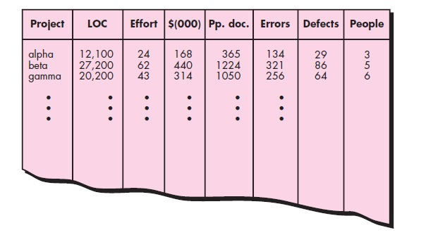
Size-Oriented Metrics

Slide 27
Function-Oriented Metrics
Function point (FP)…..

Slide 28
Object-Oriented Metrics
Number of scenario scripts
Number of key classes
Number of support classes
Average number of support classes per key class
Number of subsystems

Slide 29

WebApp Project Metrics
Number of static web pages
Number of dynamic web pages
Number of internal page links
Number of persistent data objects
Number of external systems interfaced
Number of static content objects
Number of dynamic content objects
Number of executable functions
The value of C ranges from 0 to 1. As C grows larger, the level of WebApp customization becomes a significant technical issue.

Slide 30
Metrics for Software Quality
Defect Removal Efficiency
    DRE = E/(E+D)
where, E is the number of errors found before delivery of the software to the end user and
D is the number of defects found after delivery.
The ideal value for DRE is 1. That is, no defects are found in the software.

Slide 31
Two types of uses for process metrics
Private metrics :
measures taken of an individual's software process.
These are usually private to the individual or team.
Used to improve an individual's performance or
personal software process.
– Example: defect rate for an individual.
Public metrics:
measures taken at a team level. These are made public to the organization. Used to improve an organizations process maturity.
– Example: defects found after release per KLOC.

Slide 32
Example: SafeHome Functionality
Test Sensor
Password
SafeHome System
Sensors
User
Zone Setting
Zone Inquiry
Sensor Inquiry
Messages
User
Sensor Status
Panic Button
(De)activate
(De)activate
Monitor and Response System
Password, Sensors, etc.
Alarm Alert
System Config Data

Slide 33
Identify the entities of the application INFORMATION DOMAIN VALUES
Compute count total
Compute VAF
Compute FP
Analyse FP

Slide 34
INFORMATION DOMAIN VALUES
External Inputs (EI)
External Outputs (EO)
External Inquiries (EI)
Internal Logical Files (ILF)
External Interface Files (EIF)

Slide 35
Information Domain Values
Number of external inputs
password, panic button, activate/deactivate (3)
Number of external outputs
  messages and sensor status (2)
Number of external inquiries
  zone inquiry and sensor inquiry (2)
Number of internal logical files
System configuration file (1)
Number of external interface files
test sensor, zone setting, activate/deactivate, and alarm alert (4)

Slide 36
Compute the number of function points (FP)
FP=CountTotal*[0.65+0.01*ɛ(F_{i})]

Slide 37
Metrics for Analysis models
Identify/collect the information domain values
Complete the table shown below to get the count total
  Associate a weighting factor (i.e., complexity value) with each count based on criteria established by the software development organization
Evaluate and sum up the adjustment factors (see the next two slides)
  “F_{i}” refers to 14 value adjustment factors, with each ranging in value from 0 (not important) to 5 (absolutely essential)
Compute the number of function points (FP)
FP = count total * [0.65 + 0.01 * ɛ(F_{i})]
Information Weighting Factor
Domain Value Count Simple Average Complex
External Inputs _____ x 3 4 6 = _____
External Outputs _____ x 4 5 7 = _____
External Inquiries _____ x 3 4 6 = _____
Internal Logical Files _____ x 7 10 15 = _____
External Interface Files _____ x 5 7 10 = _____
Count total ________

Slide 38
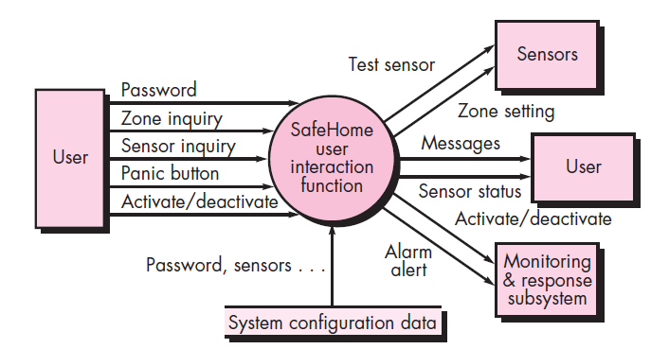
A data flow model for Safe Home software
Number of external inputs
password, panic button, activate/deactivate (3)
Number of external outputs
  messages and sensor status (2)
Number of external inquiries
  zone inquiry and sensor inquiry (2)
Number of internal logical files
System configuration file (1)
Number of external interface files
test sensor, zone setting, activate/deactivate, and alarm alert (4)

Slide 39
Value Adjustment Factors
Does the system require reliable backup and recovery?-9
Are specialized data communications required to transfer information to or from the application?-1
Are there distributed processing functions?-
Is performance critical?
Will the system run in an existing, heavily utilized operational environment?
Does the system require on-line data entry?
Does the on-line data entry require the input transaction to be built over multiple screens or operations?
(More on next slide)

Slide 40
Value Adjustment Factors (continued)
Are the internal logical files updated on-line?
Are the inputs, outputs, files, or inquiries complex?
Is the internal processing complex?
Is the code designed to be reusable?
Are conversion and installation included in the design?
Is the system designed for multiple installations in different organizations?
Is the application designed to facilitate change and for ease of use by the user?

Slide 41
Function Point Example
Information Weighting Factor
Domain Value Count Simple Average Complex
External Inputs 3 x 3 4 6 = 9
External Outputs 2 x 4 5 7 = 8
External Inquiries 2 x 3 4 6 = 6
Internal Logical Files 1 x 7 10 15 = 7
External Interface Files 4 x 5 7 10 = 20
Count total ----------------------------------------------------------> 50
FP = count total * [0.65 + 0.01 * sum(F_{i})]
FP = 50 * [0.65 + (0.01 * 46)]
FP = 55.5 (rounded up to 56)
1 fp=60 LOC,1 LOC-x per-y num days

Slide 42
1 FP – 60 LOC
12 FPs- Can be produced for each person- month
1FP - On Avg 3 errors during analysis and design
1 FP - On Avg 4 errors during unit and integration testing

Slide 43
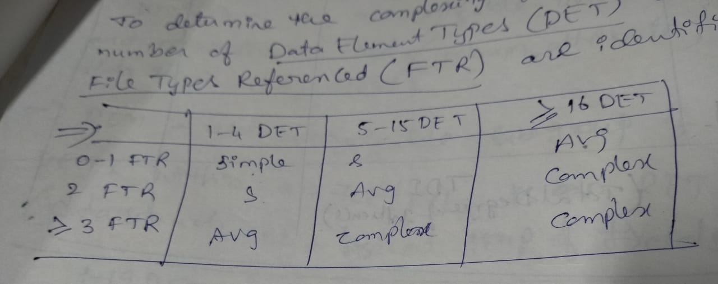

Slide 44
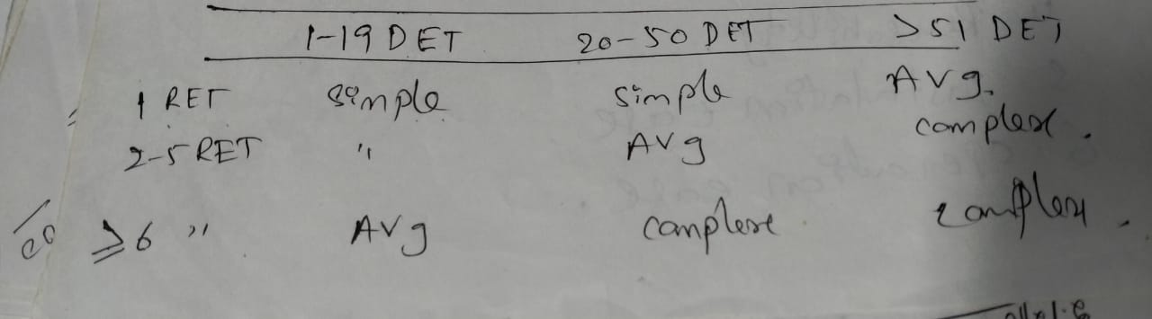

Slide 45
Metrics for the Design Model

Slide 46
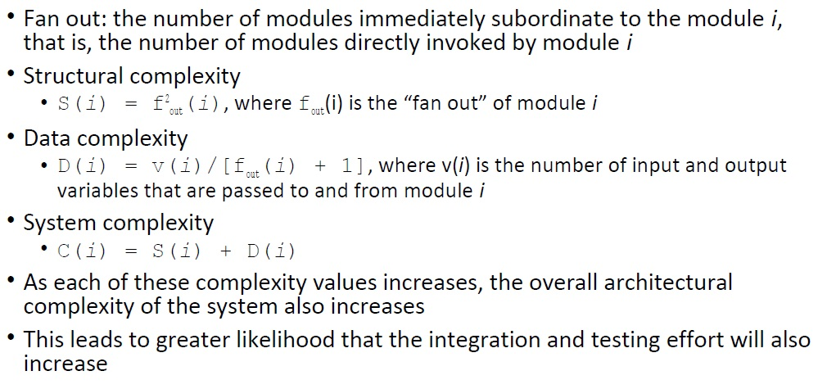
Architectural Design Metrics

Slide 47
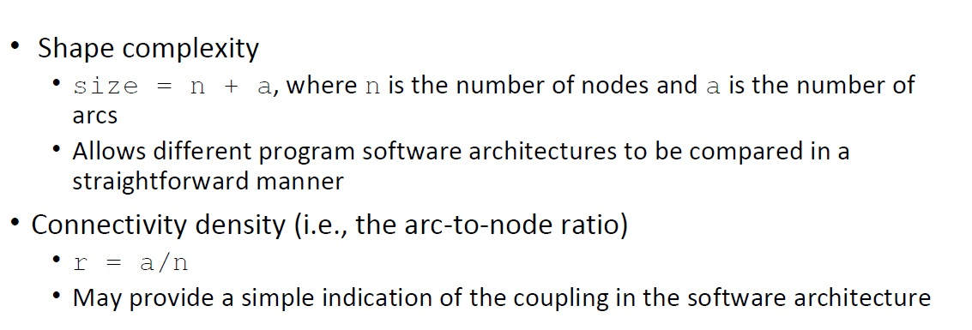

Slide 48
Metrics for Object-Oriented Design
Size
Coupling
Sufficiency
Completeness
Cohesion
Primitiveness
Similarity
Volatility

Slide 49
Class-Oriented Metrics—
(The CK Metrics Suite)
Weighted methods per class (WMC).
Depth of the inheritance tree
Number of children
Coupling between object classes
Response for a class
Lack of cohesion in methods

Slide 50
Metrics for Source Code
The measures are:
  n1 number of distinct operators that appear in a program
  n2 number of distinct operands that appear in a program
  N1 total number of operator occurrences
  N2 total number of operand occurrences

Slide 51
Halstead shows that length N can be estimated
N = n1 log2 n1 + n2 log2 n2
and program volume may be defined
V = N log2 (n1 + n2)
It should be noted that V will vary with programming language.

Slide 52
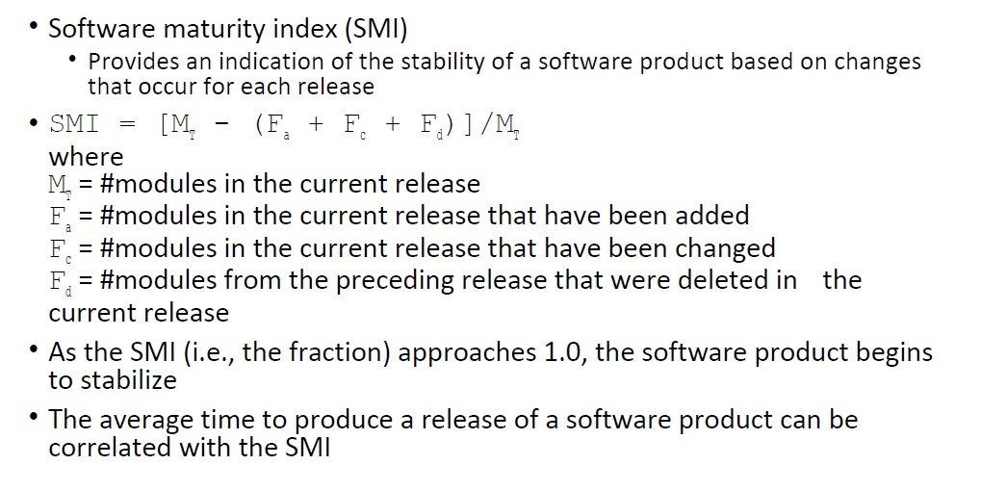
Metrics for Maintenance

